Slide 1
Code Customer Management Module
Task List:
Code CustomerDAO + Unit tests
Implement Create Customer feature
Implement List Customers feature
Implement Edit Customer feature
Implement Delete Customer feature

Slide 2
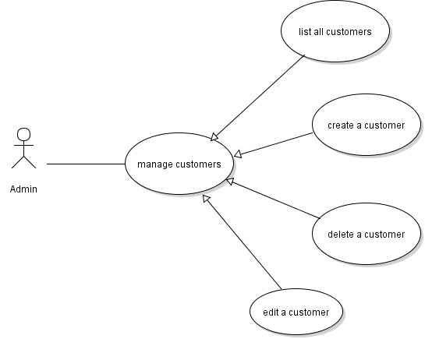
Customer Management Use Cases

Slide 3
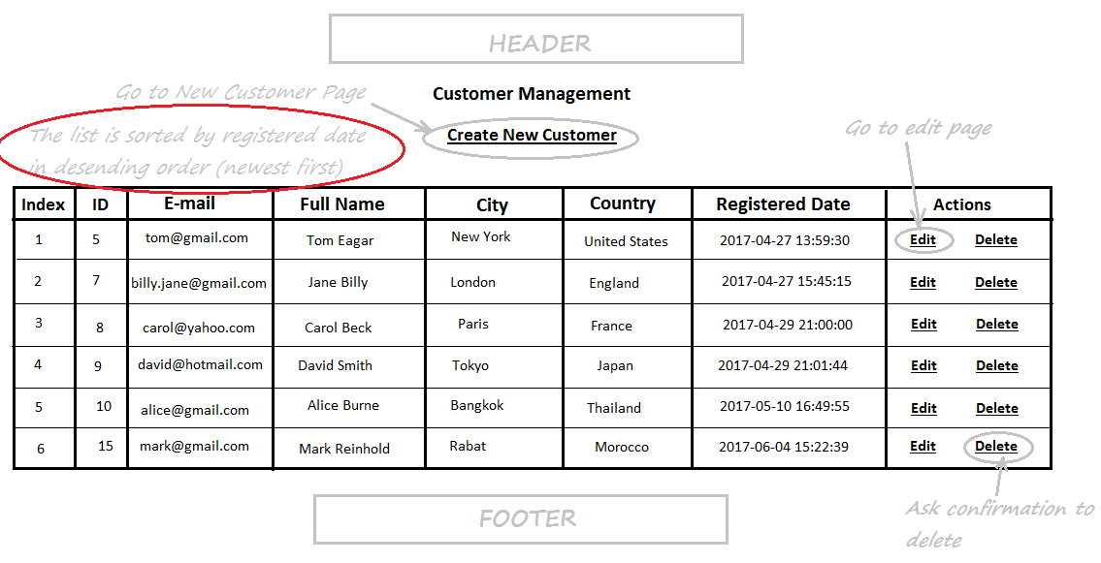
Customers List Page

Slide 4
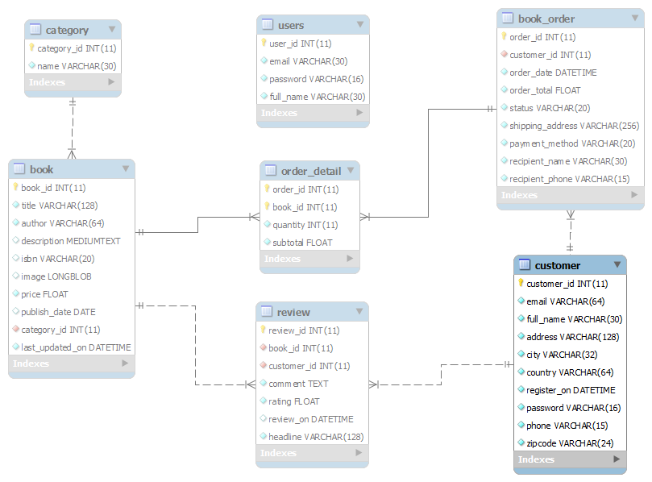
Database Design – Table customer

Slide 5
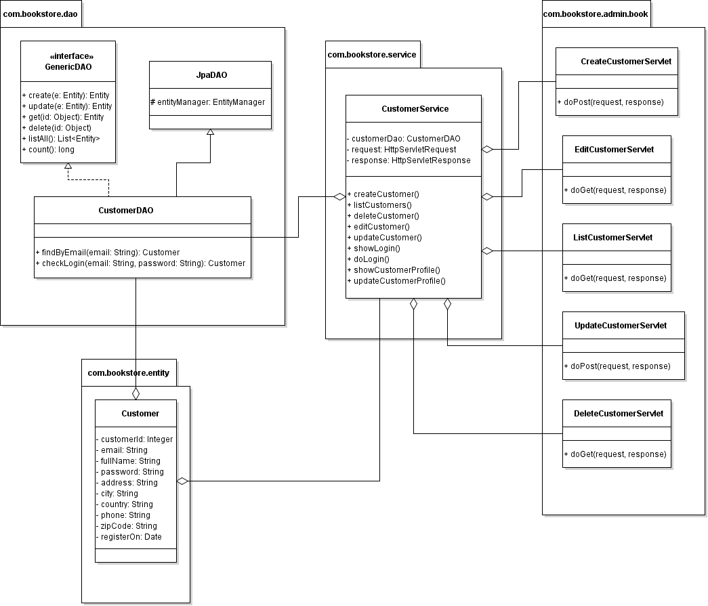
Class Diagram

Slide 6
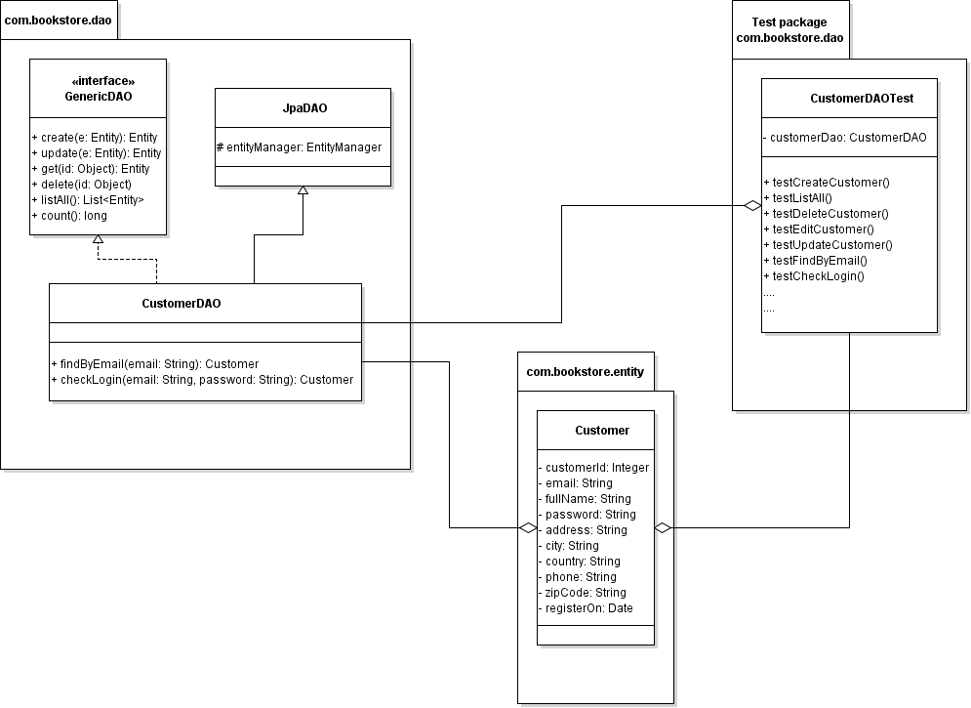
Code CustomerDAO

Slide 7
Implement List Customer feature
Code ListCustomerServlet
Update CustomerServices
Code Customer List Page (HTML + JSTL)

Slide 8
Customers List Page

Slide 9
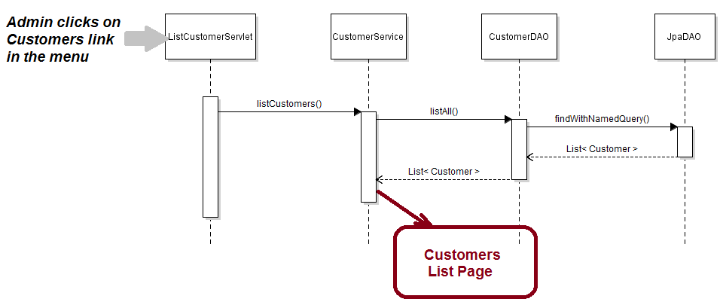
List Customers Sequence Diagram

Slide 10
Implement Create Customer Feature
Code Customer Form Page (JSP)
Validate Form’s Input (jQuery)
Code CreateCustomerServlet Class
Code CustomerServices Class

Slide 11
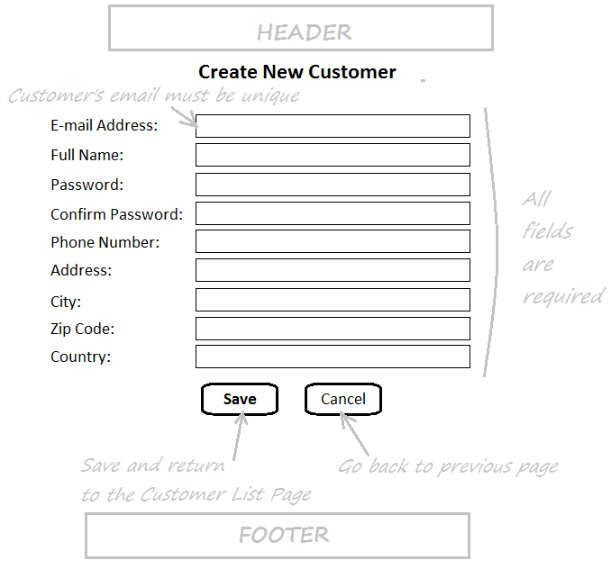
Customer Form Page

Slide 12
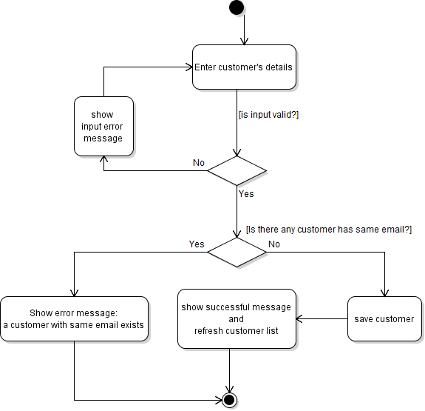
Activity Diagram: New Customer

Slide 13
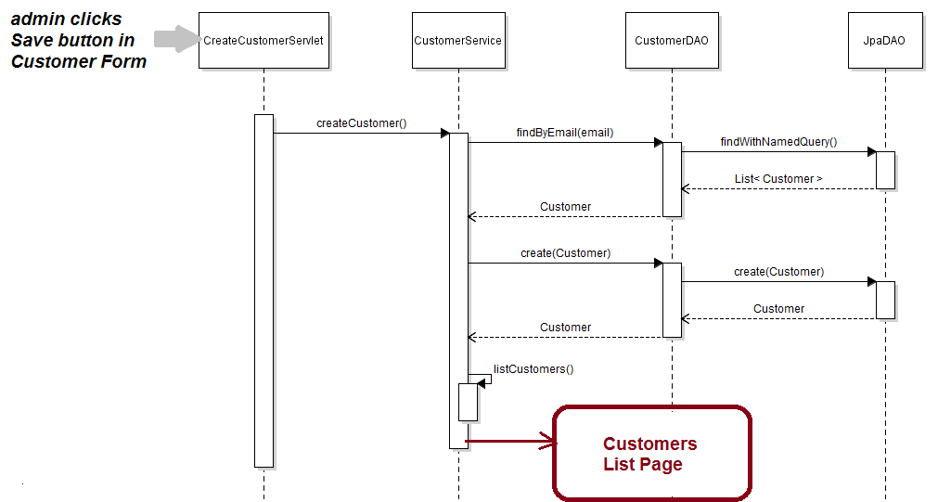
Sequence Diagram: New Customer

Slide 14
Implement Edit Customer Feature
Create EditCustomerServlet Class
Update Customer Form Page (JSP)
Create UpdateCustomerServlet
Update CustomerServices Class

Slide 15
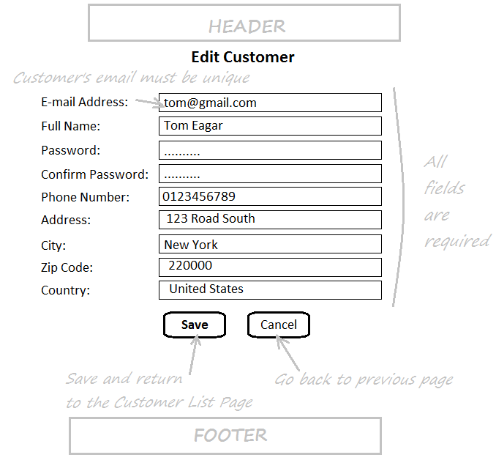
Customer Form in Edit mode

Slide 16
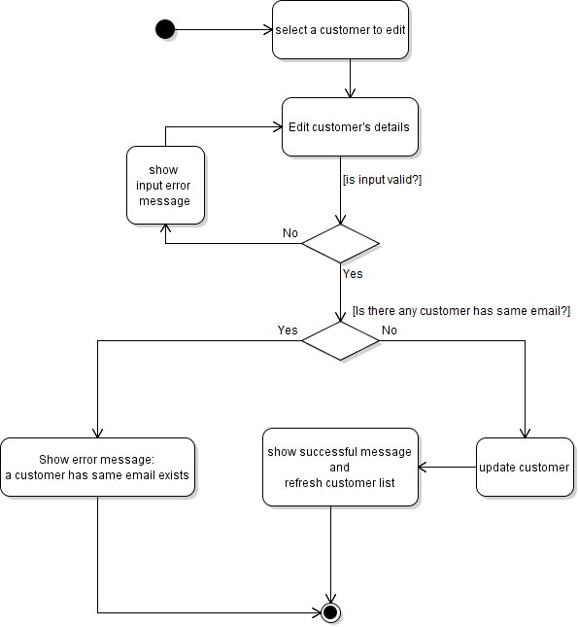
Activity Diagram: Update Customer

Slide 17
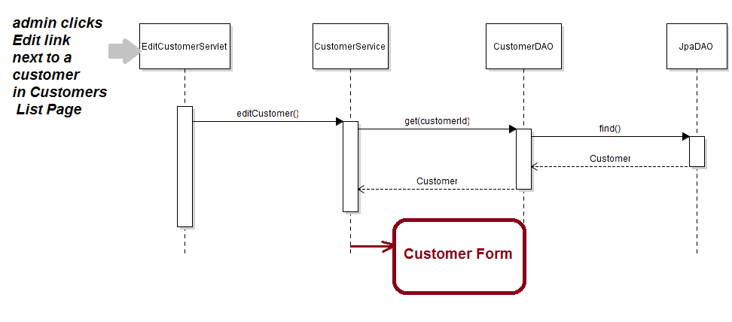
Sequence Diagram: Edit Customer

Slide 18
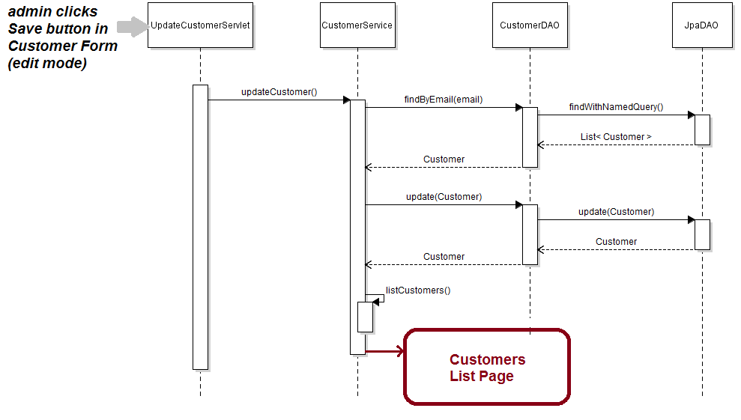
Sequence Diagram: Update Customer

Slide 19
Implement Delete Customer Feature
Show Delete Confirmation Dialog
Create DeleteCustomerServlet
Update CustomerServices Class

Slide 20
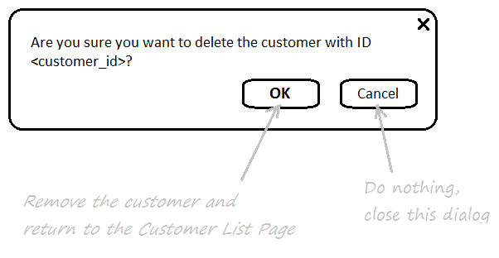
Delete CustomerConfirmation Dialog

Slide 21
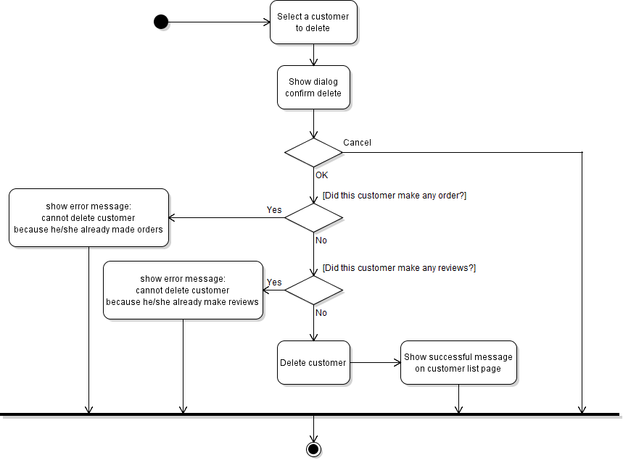
Activity Diagram: Delete Customer

Slide 22
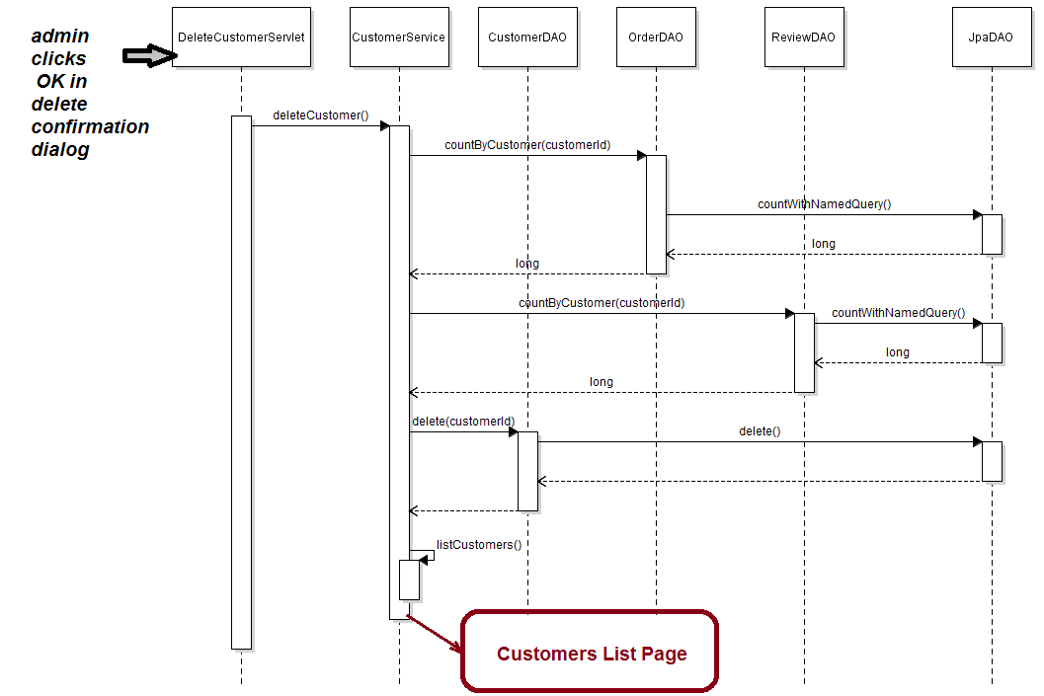
Sequence Diagram: Delete Customer

